Slide 1
DATABASE PROGRAMING BIT-3207
Lecture 5 – Wednesday 30th September 2015
Views

Slide 2
Views – What are they?
A View in SQL is a Virtual Table based upon a result set.
We use views to access data in a format that we access frequently.
For example, we may want to display the daily workers/Students attendance after registration in form of a report
Note: The data retrieved is always up to date as the View retrieves data from the original tables.
You can add SQL functions, WHERE, and JOIN statements to a view and present the data as if the data were coming from one single table.
It could easily help you store queries (>1) you would rather be repeating daily.

Slide 3
Views – Creating a View
To create a view we attach a SELECT statement to the CREATE VIEW statement
The syntax is as follows:
CREATE VIEW name_of_view AS
SELECT column1, column2
FROM table_name(s)
WHERE conditions

Slide 4
views – Creating a View
For example, we may want to view the daily student attendance details
This is going to be repeating daily, we need to create a view .
To avoid writing a complex query of selecting from various tables we can write a view and select from it.
The first example below shows a JOIN without a view which is repeatedly written daily .
The second example shows how we can create a view and get the same results

Slide 5
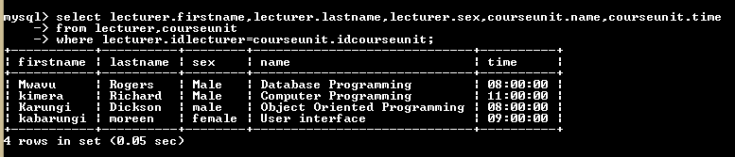
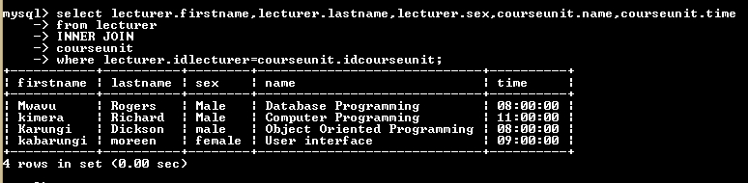
Views – Creating a View
Example of a JOIN minus a view
Selecting the lecturer names and the course unit taught

Slide 6

Views: Creating a View
The View name is called lecturer_details
NB: A view is automatically updated each time data is added so u don’t need to update it

Slide 7
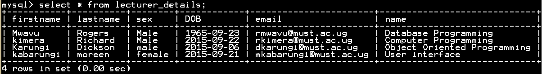
Views: Selecting from a view
Here the selection is from a view and the output is the same as the one in the Join

Slide 8
Example 2: Creating Views
We might have a promotion in our company to reduce on our products with a discount of 2 percent per sale.
Each time a customer buys a product we get the total paid minus the amount for discount to get the total discounted price
We can create a view to show the price for each product bought without altering the table but working with the view only as below.

Slide 9
Example 2:
Discount=2% * Original Price
Cost = Original price - discount
Get a discounted total price.
Without the view, it would be as in the next slide:

Slide 10
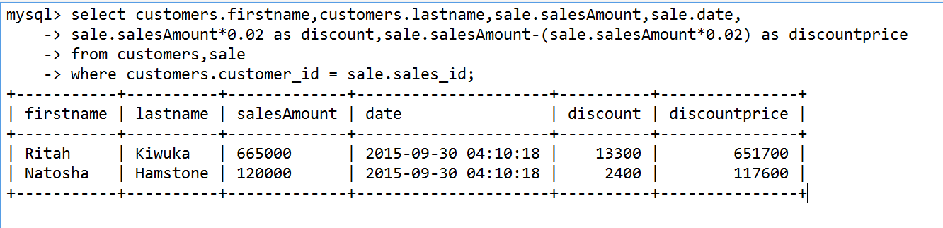
Ex2: without view

Slide 11
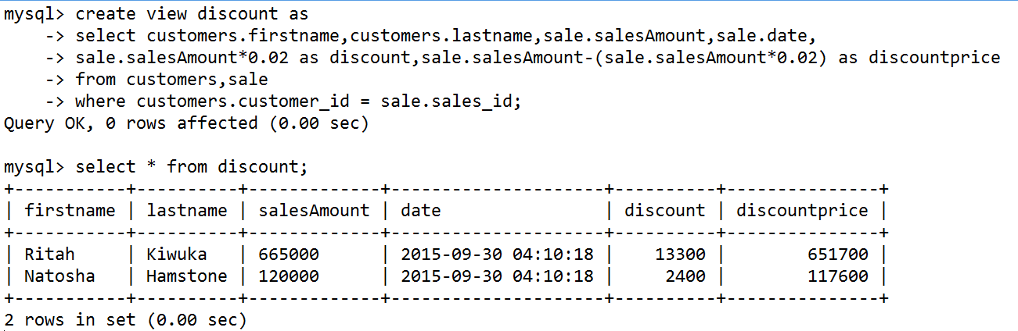
Ex2: with a view

Slide 12
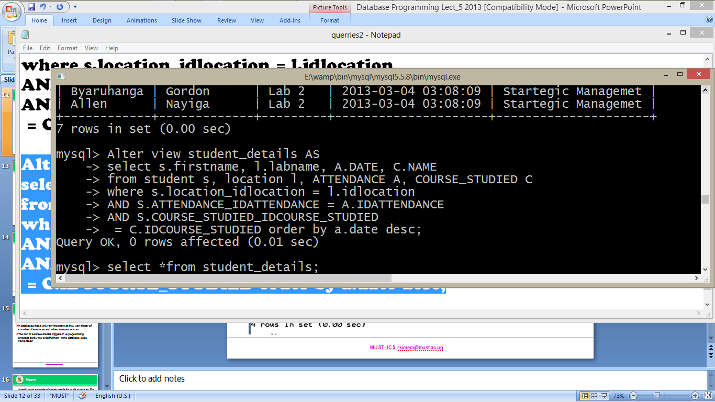
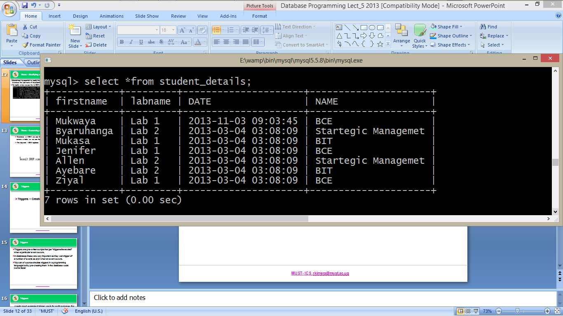
Views – Modifying a View
Sometimes it is essential to modify the content of a view, for example: We may wish to remove the Last name of the student and organise our data in descending order
To modify a view we use the ALTER VIEW command

Slide 13
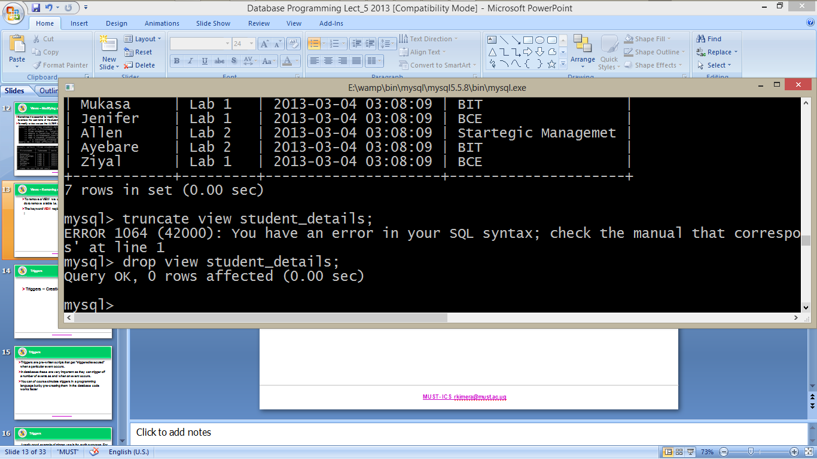
Views – Removing a View
To remove a VIEW we use the same command as we do to remove a table i.e. we use the DROP command,
The keyword VIEW replaces the word TABLE however
Note
The truncate command does not work with views, its only Drop that can be used to completely erase the view

Slide 14
Next Lecture
TRIGGERS

